Slide 1

Android 11 Enterprise Developer Overview
James Swinton-Bland
Developer Advocate EMEA
James.swintonbland@zebra.com

Slide 2

Agenda
Overview
  Trends Over Time (L -> 11 (R))
  A10 Recap (scoped storage, device identifiers & more…)
Zebra Updates for A11
  Slimmed Down OS
  DotCode Erasures
  Secure Storage Manager
  More to come before release…
A11 Updates (APIs)
  Scoped Storage
  Permission changes
  Custom Toast depreciations
A11 Updates (Utilities)
  Wireless debugging
  Screen recording
  Test-App compatibility

Slide 3

Trends & A10 Recap

Slide 4







Overview
Trends Over Time
Running in the background​ | Job Scheduler​ | Doze mode​ | Doze “on the go”​ | Background restrictions​ | Machine learning for intelligent restrictions​ | New background location​ permission | Background Location permission
Notifications​ | Quick settings & notification shade​ | Long press to access options​ | Direct reply & bundled notifications​ | Notification channels & snooze​ | Enhanced messaging experience​ | Notification bubbles (native support)​ | Foreground Service Types
Other changes ​ | Material design​ | Runtime permissions​ | Multi-window​ | Changes to the Google Play Store policies​ | Non-SDK methods actively discouraged​ | External storage changes​ | Scoped Storage enforcement
Enterprise features​ | Android for Work, app restrictions​ | DO mode, lock task mode, managed configs​ | DPM API enhancements​ | DPM API enhancements​ | DPM API enhancements​ | Transition to DO mode​ | DPM API enhancement

Slide 5
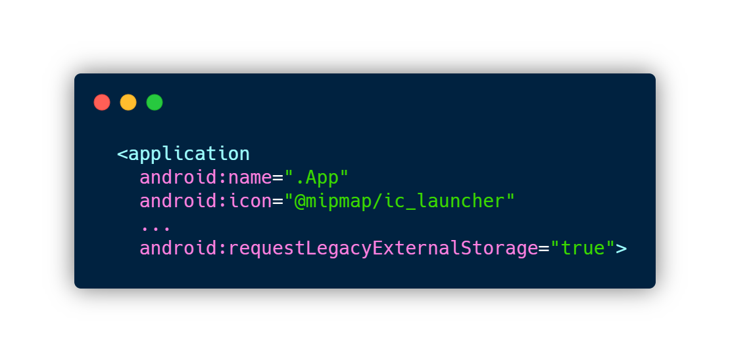
A10 Recap
Scoped Storage
Restricts access to files outside of applications installation directory or Scoped Storage
A10 provided a mechanism to opt-out via Manifest tag to allow developers to migrate their apps
Enforced for all applications on A11, with a few exceptions

Slide 6
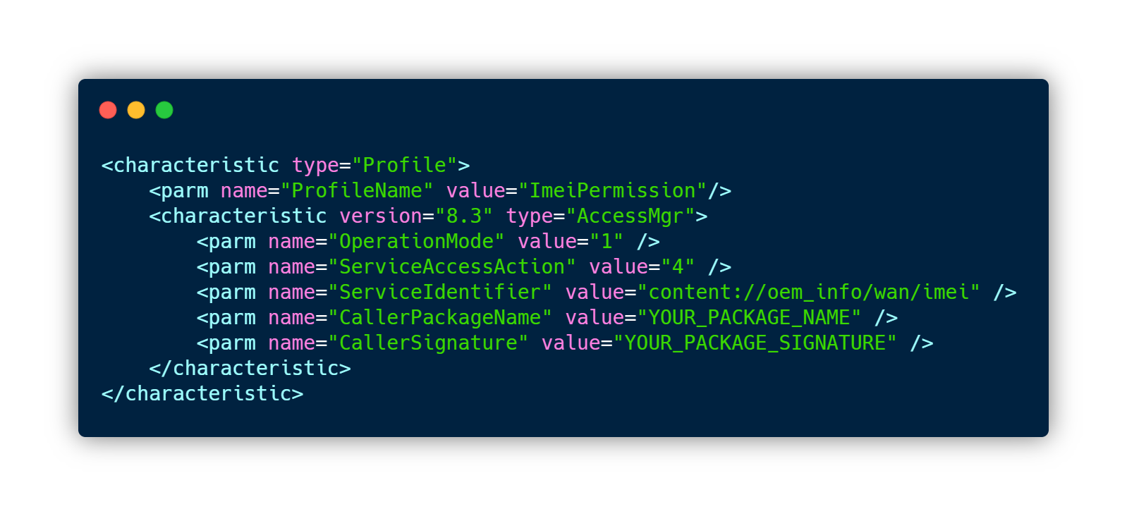
A10 Recap
Device Identifiers
A10 prevents apps from accessing non-resettable device identifiers (IMEI, Serial & MAC)
DO applications request access with READ_PRIVILEGED_PHONE_STATE permission
Zebra expose identifiers via Content Providers, protected by MX

Slide 7
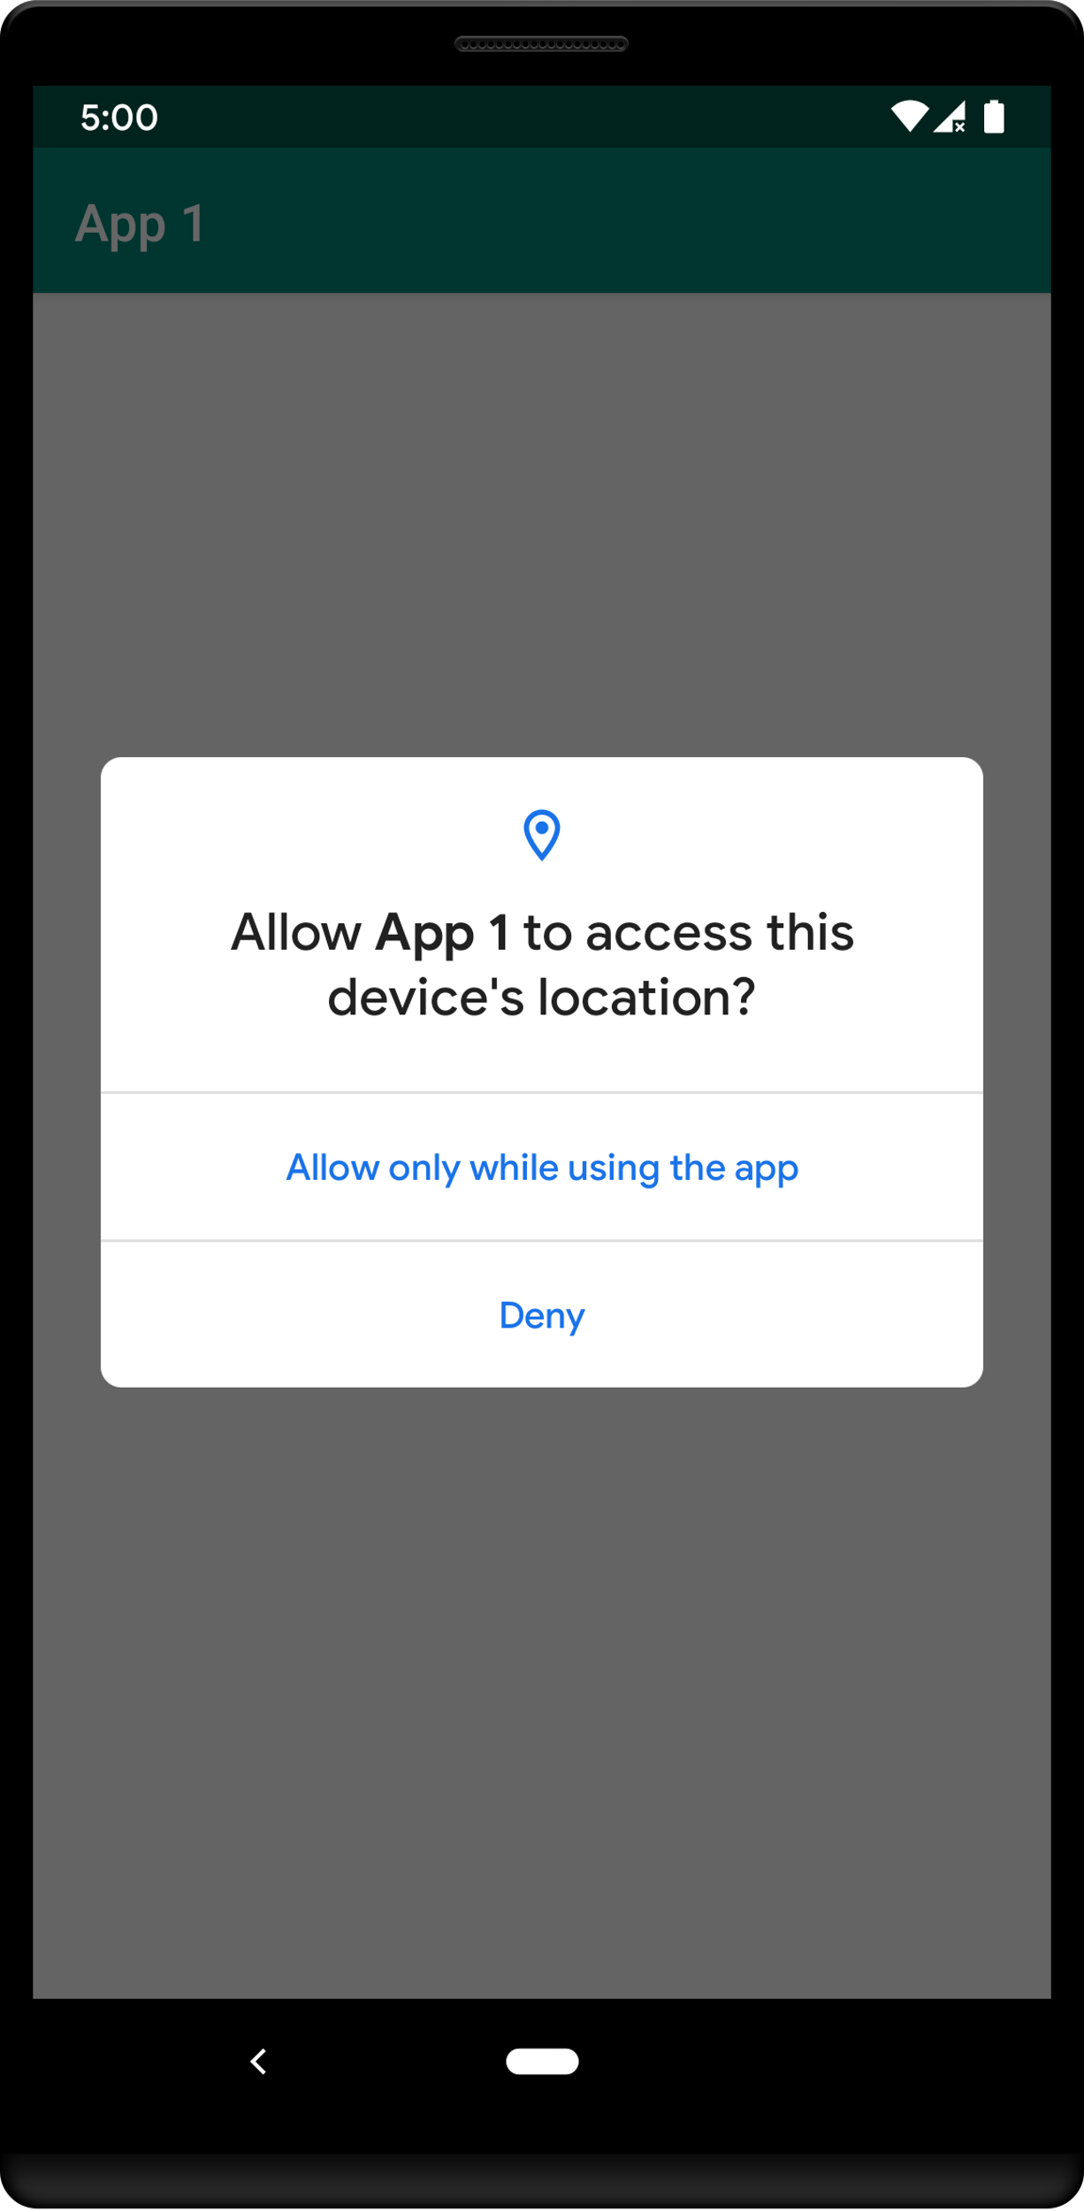
A10 Recap
Background Location Permissions
New permission introduced in A10 ACCESS_BACKGROUND_LOCATION
Restricts location permission to when the app is in the foreground (in use)
Typical work-around is to launch a foreground service

Slide 8
Zebra Updates for A11

Slide 9
Zebra Changes for A11
Slimmed Down OS
Less apps come pre-installed as default and instead will be distributed by Google Play and/or Zebra Support Site
Key applications will still be shipped with the OS:
  DataWedge
  StageNow
  RxLogger etc…
Features can be released quicker, update packages will be smaller and will require less testing

Slide 10
Zebra Changes for A11
Secure Storage Manager
Zebra have introduced new feature called Secure Storage Manager
Designed to allow apps to share files in spite of Scoped Storage restriction
More detail to come in later slides…

Slide 11
Zebra Changes for A11
Improved DotCode Support
Much improved DotCode performance
Configurable erasures allow for much more aggressive decoding
Noticeable performance increase,
  Available previously as CPR
  Standard in A11

Slide 12
A11 Updates (Scoped Storage)

Slide 13
A11 Updates (APIs)
Scoped Storage
What is it
What are the work-arounds
A closer look at the work-arounds

Slide 14
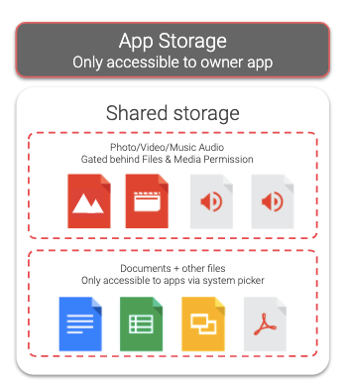
A11 Updates (APIs)
Scoped Storage – What is it?
Apps cannot access files outside of their application directory – Their “Scoped Storage”
Introduced in A10
  Rollout delayed due to community push-back
Enforced in Android 11
  With caveats…

Slide 15
A11 Updates (APIs)
Scoped Storage – What are the workarounds?
Currently, there are four viable work arounds:
  /sdcard/downloads/ Folder
  preserveLegacyExternalStorage Manifest Flag
  MANAGE_EXTERNAL_STORAGE Permission
  Secure Storage Manager (SSM)
Each work-around has some pros/cons and some are a Zebra value-add
Lets take a closer look at each of them…

Slide 16
A11 Updates (APIs)
Scoped Storage – /sdcard/Download/ folder
/sdcard/Download/ folder is exempt from Scoped Storage – these files are world readable & writeable
This is a low-security, low-effort way of migrating applications for A11 compatibility
Personal assumption is this will not persist in A12
  Likely not a business decision, rather a technical limitation
Secure | û
Available on consumer devices? | ü
Google Play | ü
Supported in A12 | û

Slide 17
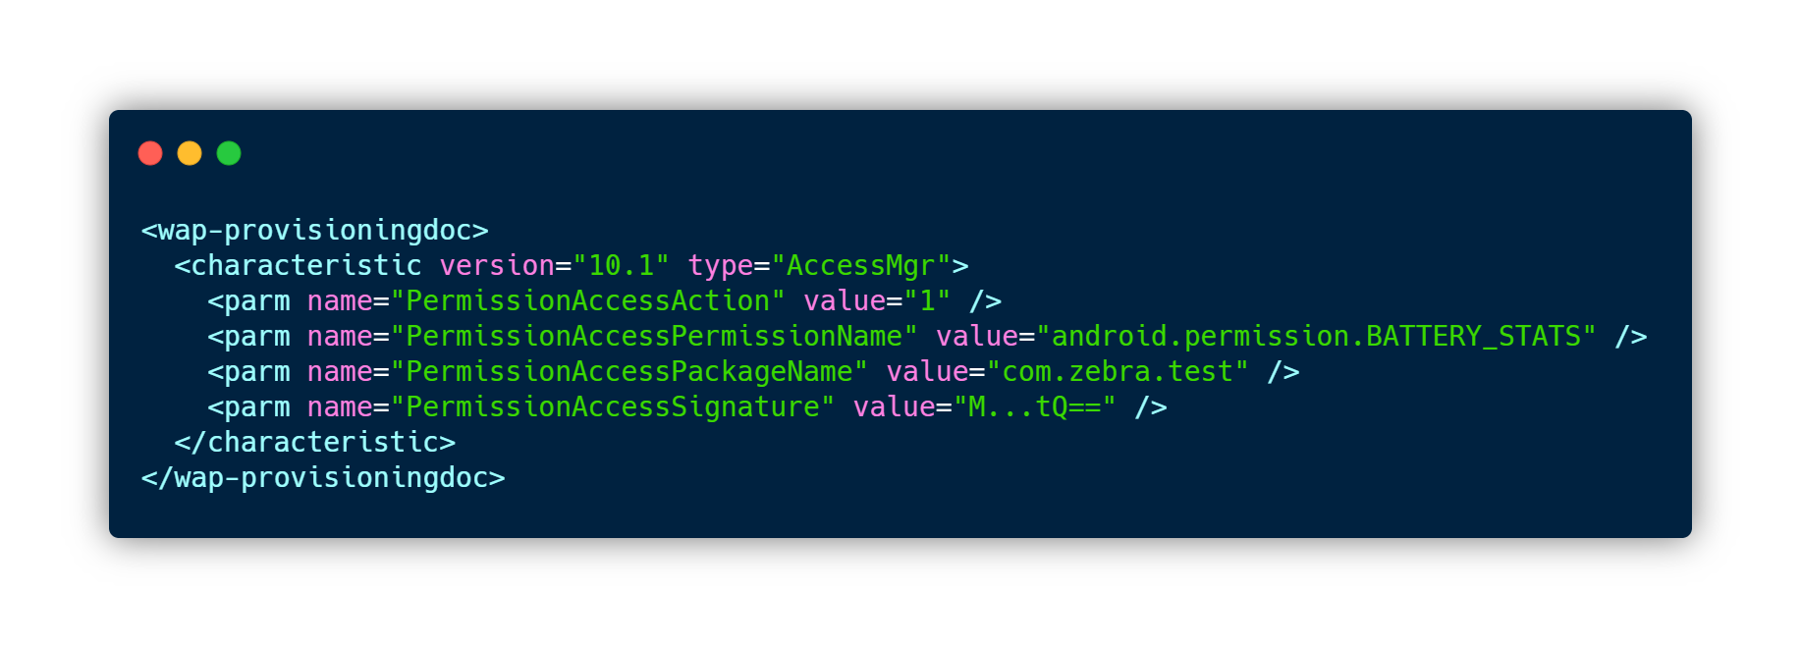
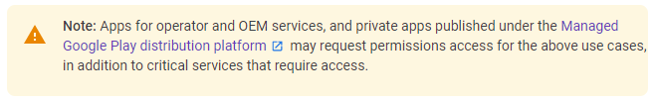
A11 Updates (APIs)
Scoped Storage – MANAGE_EXTERNAL_STORAGE Permission
Applications can request the MANAGE_EXTERNAL_STORAGE permission which will exempt them from Scoped Storage restrictions
This is a signature level permission but is exposed on Zebra devices via MX
Apps which request this permission are individually reviewed by Google & are likely to be rejected from the Play Store
Secure | ü
Available on consumer devices? | û
Google Play | û
Supported in A12 | ü

Slide 18
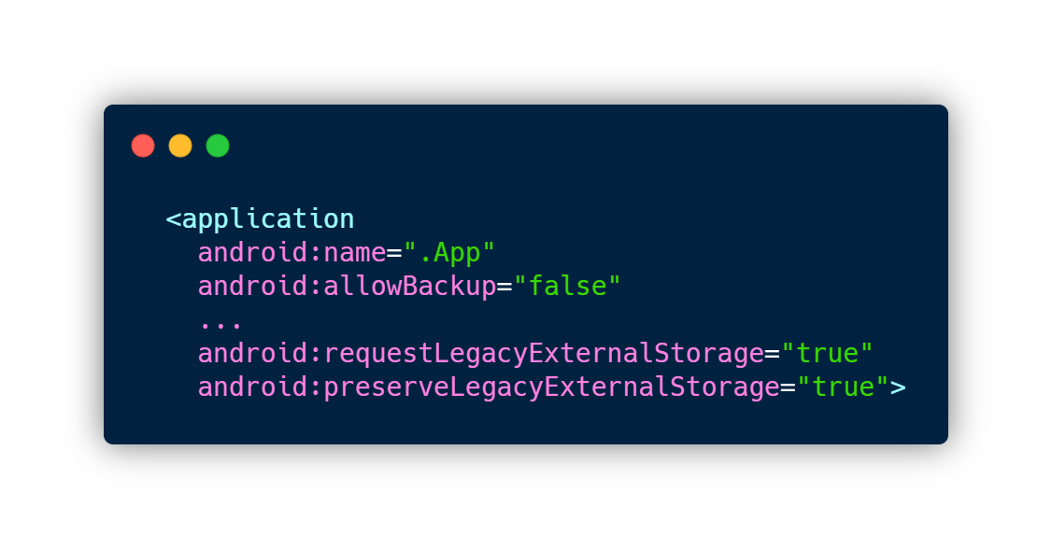
A11 Updates (APIs)
Scoped Storage – Secure Workaround, but with Caveat, pt.2
Application UPDATES can opt-out with new Manifest Tag:
  preserveLegacyExternalStorage
Workflow:
  Create app & target A10 (API 29)
  Install application
  Update app version & target A11 (API 30)
  Add preserveLegacyExternalStorage flag to manifest
  Update application on device
  Access to storage locations will now function as it did in A9
Secure | ü
Available on consumer devices? | ü
Google Play | ü
Supported in A12 | û

Slide 19
Zebra Changes for A11
Secure Storage Manager – What is it?
Content Provider from Zebra
Allows sharing of data across multiple applications
Optional file-persistence over enterprise resets
Comes pre-installed on all A11 builds
Secure | ü
Available on consumer devices? | û
Google Play | ü
Supported in A12 | ü

Slide 20
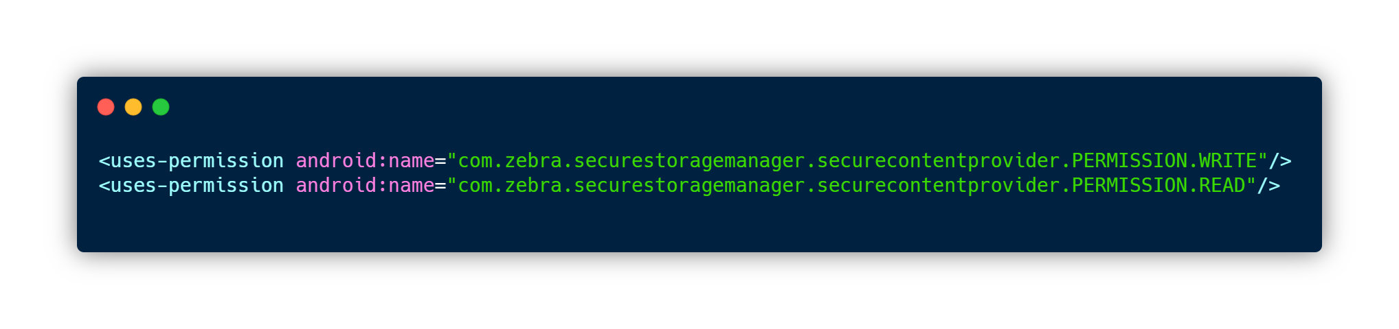
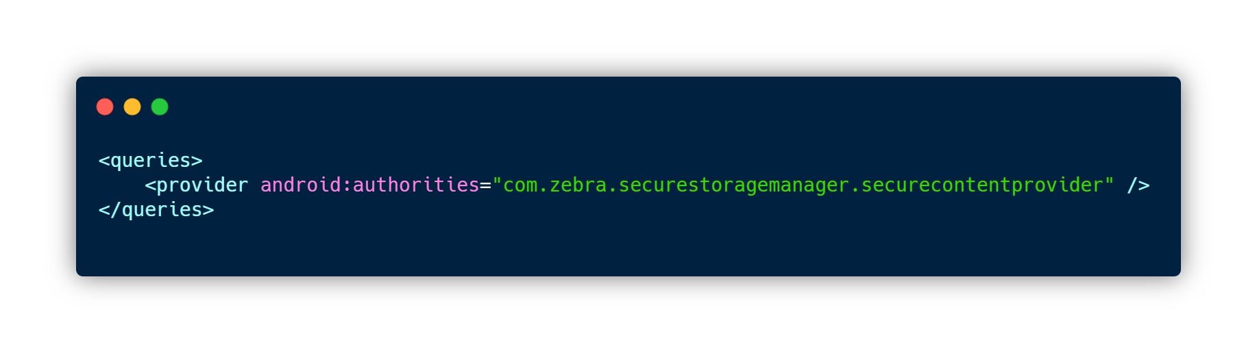
Zebra Changes for A11
Secure Storage Manager – How does it work?
Accessed in the same way as standard Content Providers
Content Providers are essentially SQLite databases
  Requires Read & Write Manifest permissions
  Requires query tag in Manifest
Secure Storage Manager exposes four interface APIs:
  Insert
  Update
  Query
  Delete

Slide 21
Zebra Changes for A11
Secure Storage Manager – How does it work?
Each row in the Content Provider has the following columns:
Key​ | Value | Required?
target_app_package | Json array of applications which can access this data. Each object in the array needs to contain the package name & signature of the application | ✓
data_name | unique name to identify data | ✓
data_value | any data (string or json) | ✓
data_persist_required | Whether persistence is required over Enterprise reset (true/false) | ✓
data_input_form | plaintext =1, encrypted=2 | ✗
data_output_form | plaintext=1, encrypted=2, keystrokes=3 | ✗

Slide 22
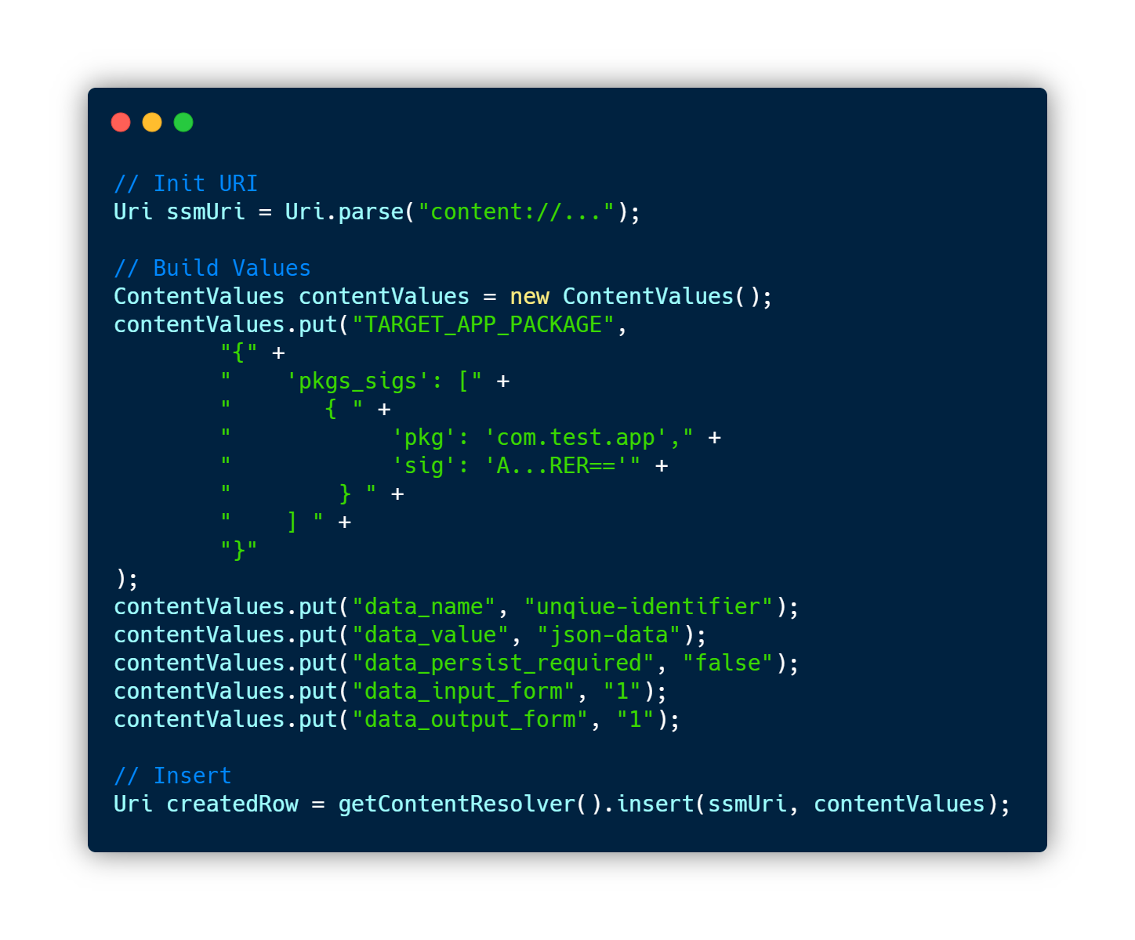
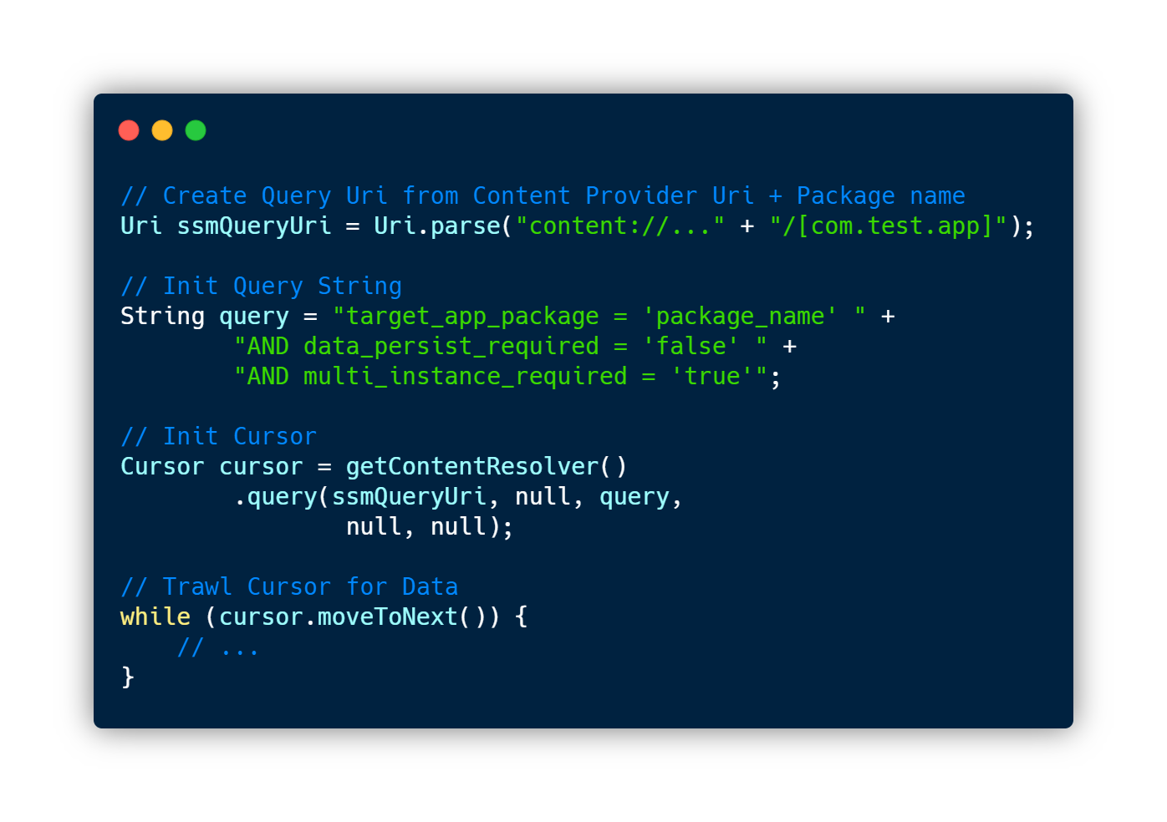
Zebra Changes for A11
Secure Storage Manager – How does it work?
Insert / Update
Query

Slide 23
A11 Updates (APIs)
Scoped Storage – Recap
 | Secure | Available on consumer devices? | Google Play | Supported in A12
/sdcard/Downloads/​ | ✗ (All apps can access & modify files) | ✓ | ✓ | ✗ (No official confirmation, but highly unlikely to be supported through A12)
Zebra Secure Storage Manager | ✓ | ✗ | ✓ | ✓
MANAGE_EXTERNAL_STORAGE | ✓ | ✗ (signature level protection) | ✗ (Individually reviewed by Play Team, exemptions here) | ✓ (No official confirmation, but highly likely to be supported through A12)
A10 -> A11 App Updates | ✓ | ✓ | ✓ | ✗ (No official confirmation, but highly unlikely to be supported through A12)

Slide 24
A11 Updates (Permissions Changes)

Slide 25
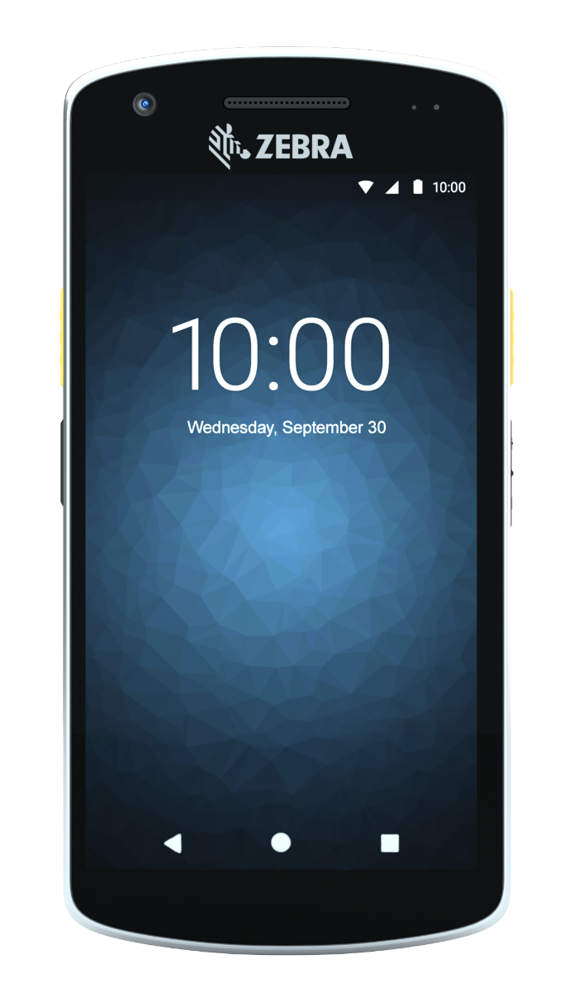
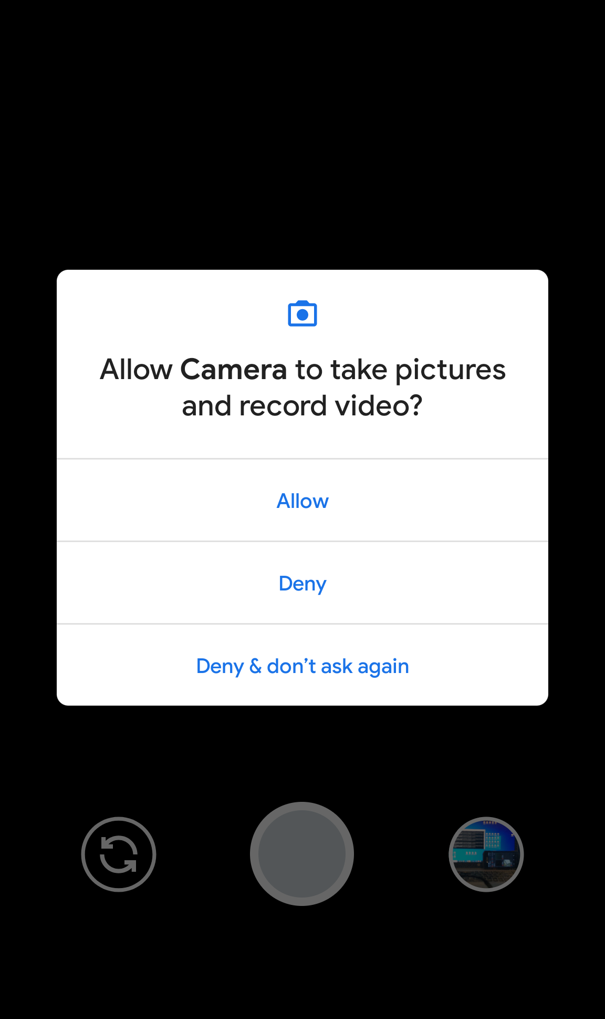
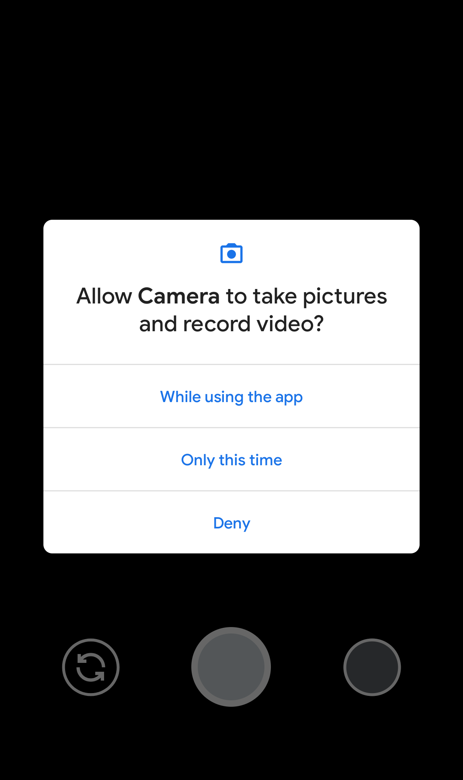
A11 Updates (APIs)
Permissions Changes
“While Using the App” (Any App on A11)
  Use given option to grant the permission only a single time
  Permission is revoked shortly after app is backgrounded – foreground services are unaffected
Deny / Don’t Ask Again Logic (Any app on A11)
  Tapping Deny twice is interpreted as Don’t Ask Again
  Checkbox to prevent asking again is removed
A10
A11
Note: None of these changes affect apps where runtime permissions have been automatically granted

Slide 26
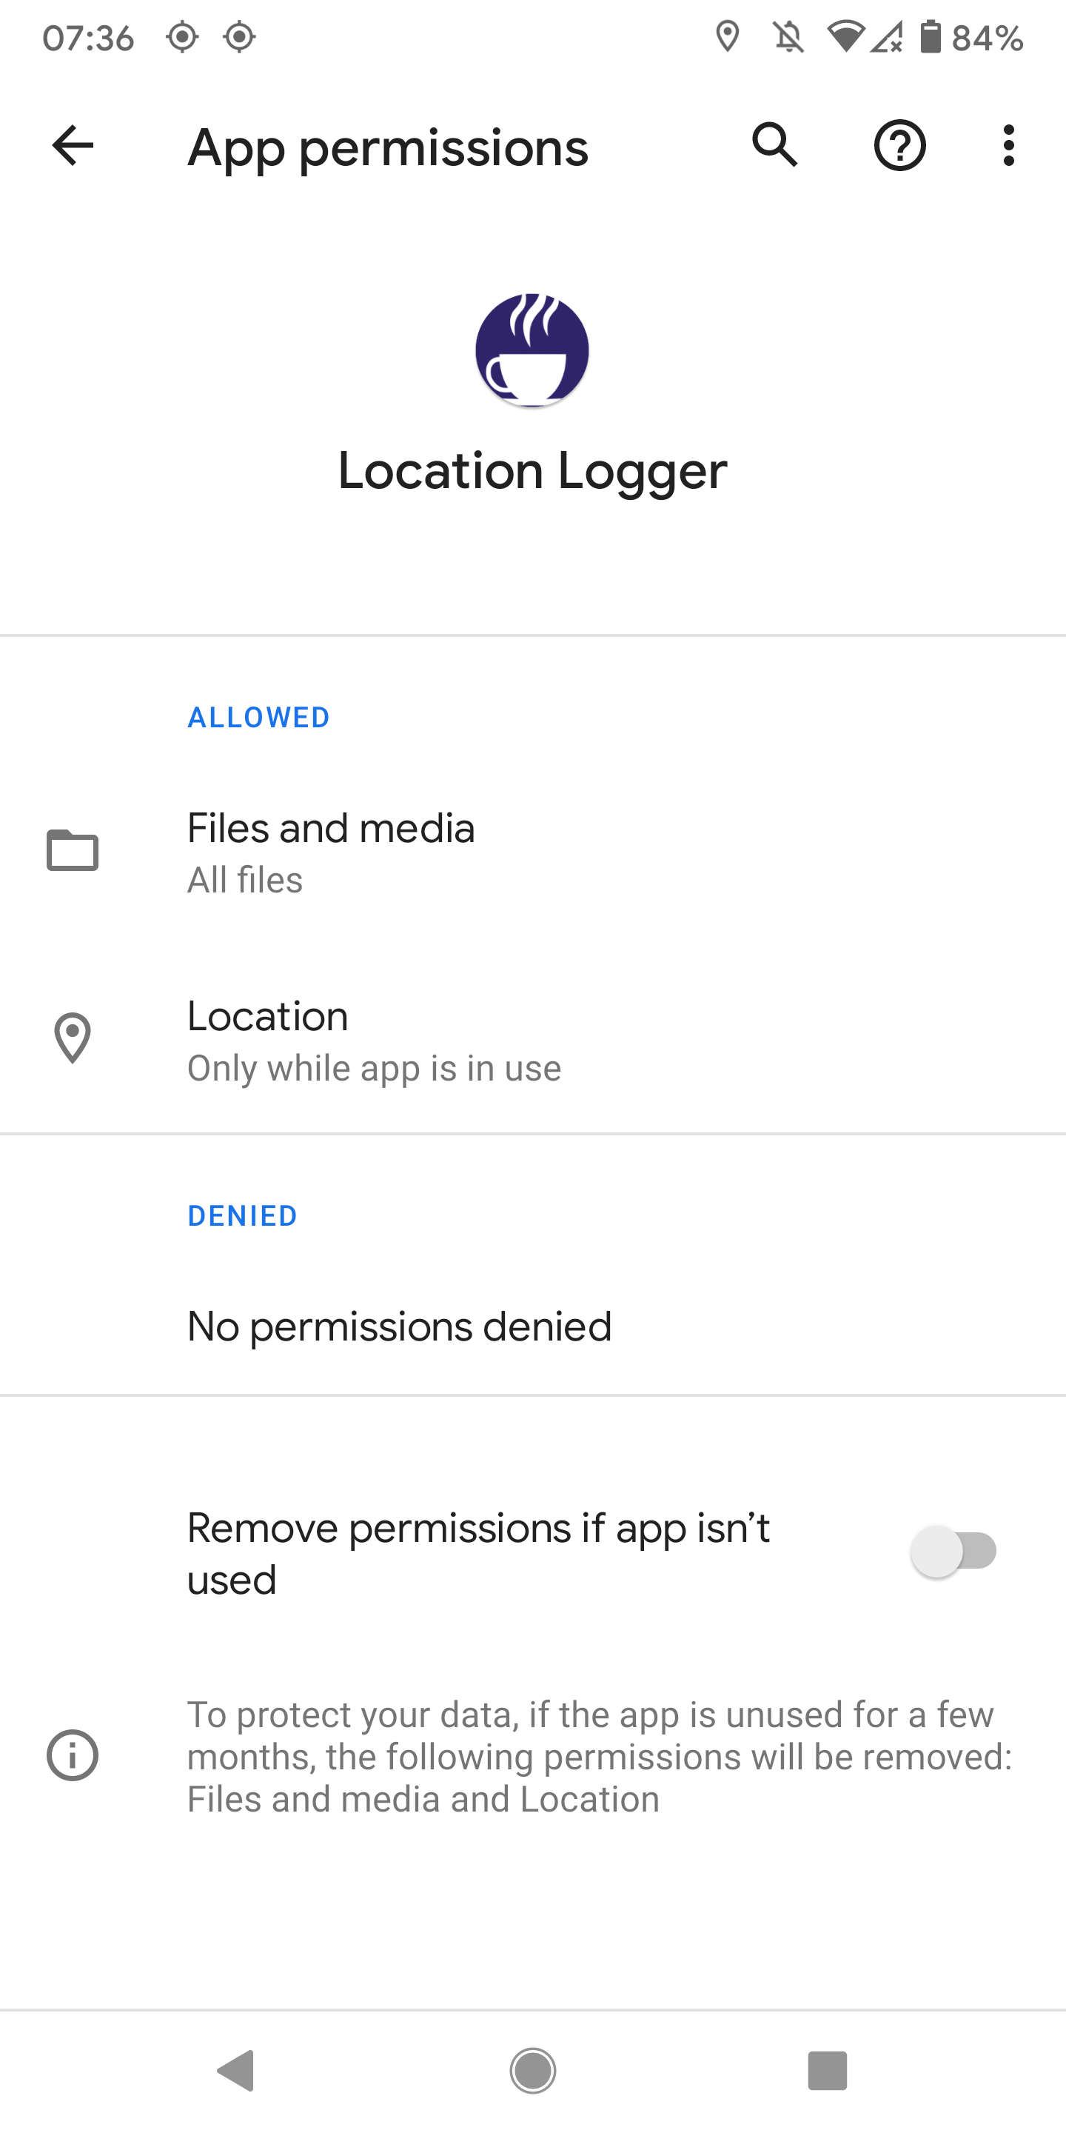
A11 Updates (APIs)
Permissions Changes
Auto-reset of Permissions (Apps Targeting API 30+)
  Permissions are revoked after app is un-used for “a few months”
  User option to enable / disable auto-reset
“Remove permissions if app isn’t used” is false as the app targeted less than API level 30. If you target 30+ this option is true by default, where shown
Note: None of these changes affect apps where runtime permissions have been automatically granted

Slide 27
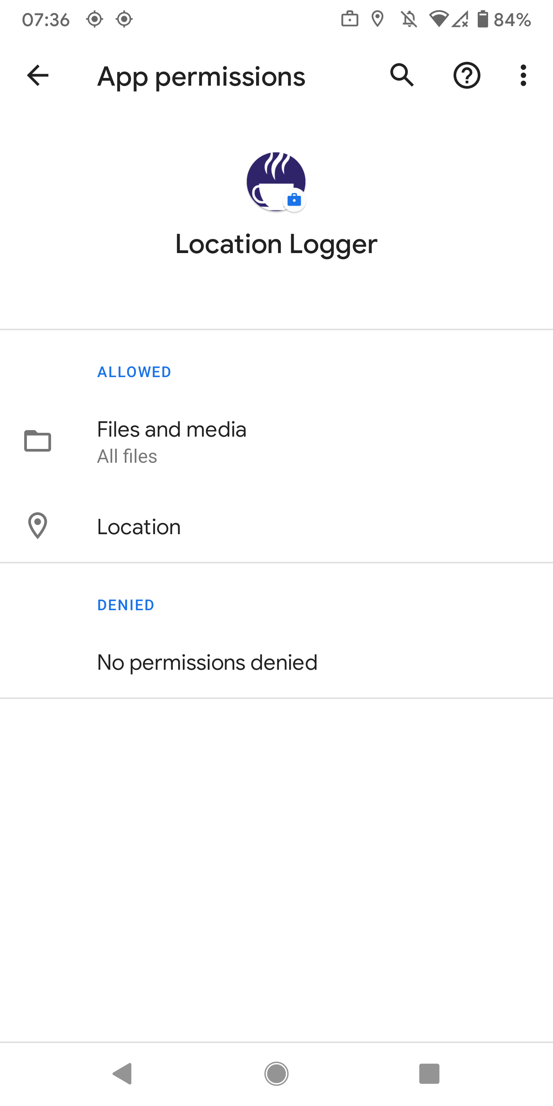
A11 Updates (APIs)
Permissions Changes
None of these changes affect apps where runtime permissions have been automatically granted
Automatically grant permissions via:
  EMM
  StageNow / MX
Note absence of “Remove permissions if app isn’t used” with EMM installation
Play Store
Installation
EMM
Installation
Note: None of these changes affect apps where runtime permissions have been automatically granted

Slide 28
A11 Updates (APIs)
Permissions Changes
System Alert Window
  User must manually grant permission
  User must manually navigate to specific app
Recommendation to grant the permission programmatically
  EMM & OEMConfig
  StageNow
  ProfileManager
Note: None of these changes affect apps where runtime permissions have been automatically granted

Slide 29
A11 Updates (Location Permissions Changes)

Slide 30
A11 Updates (APIs)
Location Permissions Changes
Android 11 makes several changes to how location permissions are handled:
Apps targeting API level 30 (A11) are NOT permitted to request foreground and background location at the same time.
  They must request ACCESS_BACKGROUND_LOCATION only after the user has granted either FINE or COARSE permission, otherwise all permissions are automatically denied.
Apps targeting API level 29 (A10) or earlier AND requesting both foreground and background location at the same time will present a warning dialog to the user.
  The default dialog includes a link to the Settings screen which is unlikely to work given Settings are typically disabled in enterprise deployments
Note: None of these changes affect apps where runtime permissions have been automatically granted

Slide 31
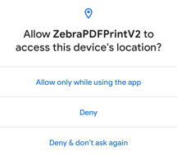
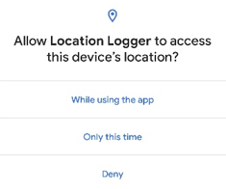
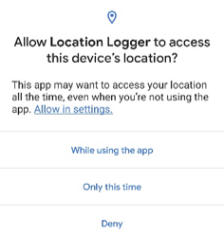

A11 Updates (APIs)
Location Permissions Changes
OS Level | 10 | 11 | 11 | 11
Target SDK | 29 (A10) | 29 (A10) | 29 (A10) | 30 (A11)
Foreground Requested | ✓ | ✓ | ✓ | ✓
Background Requested | ✓ | × | ✓ | ✓
Dialog Shown
Note: None of these changes affect apps where runtime permissions have been automatically granted

Slide 32
A11 Updates (Misc.)

Slide 33



A11 Updates (APIs)
Foreground Service Types
Android 10 introduced Foreground Service Types
  If your foreground service accessed device location, then you need to give it the “location” type.
Android 11 extends Foreground Service Types
  If your application accesses the camera, give it the “camera” type
  If your application accesses the microphone, give it the “microphone” type
These types allow Android to determine what these services are allowed to do
  E.g. FGS launched from a background app cannot use the camera or microphone

Slide 34

A11 Updates (APIs)
Custom Toast Depreciation
Custom Toasts are deprecated
Any application that tries to launch a custom toast from the background will fail
Any application that tries to launch a custom toast from the foreground will succeed but log a warning.

Slide 35
A11 Updates (Utilities)

Slide 36
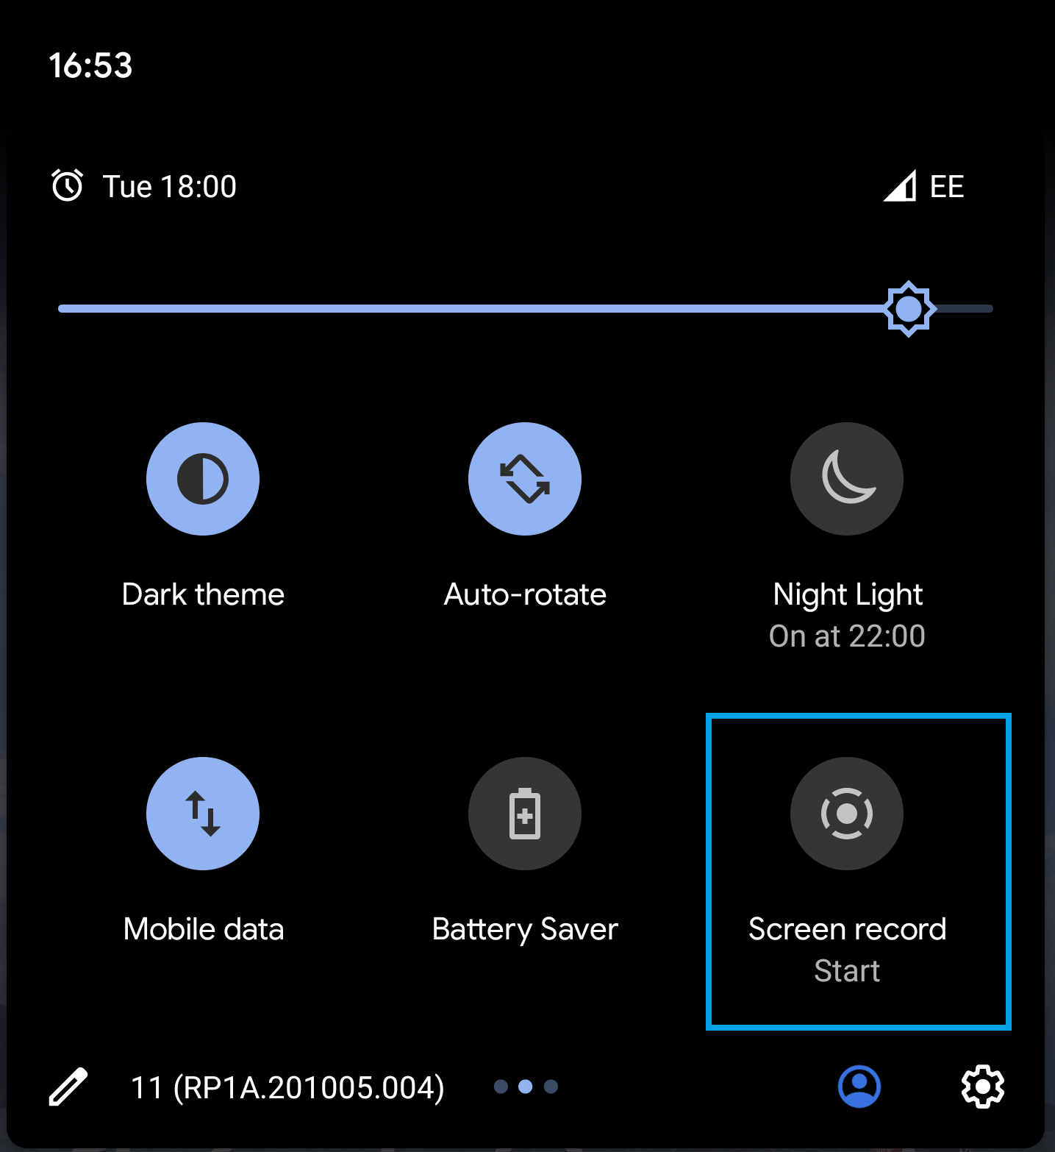
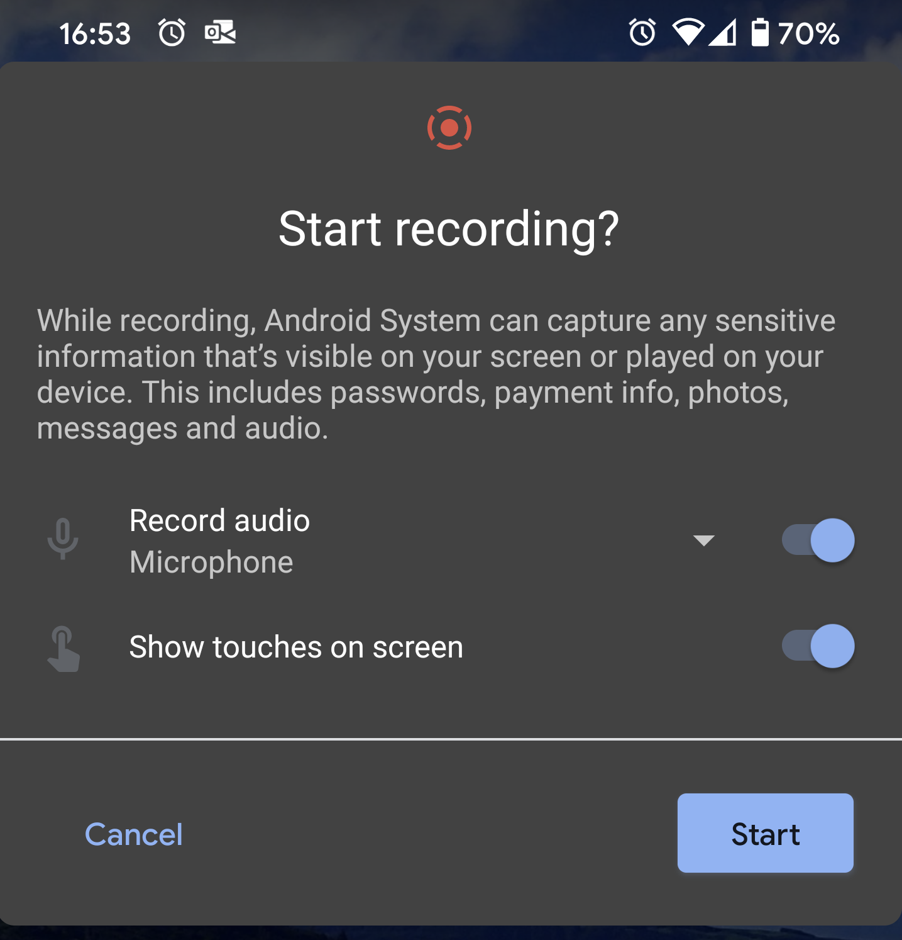
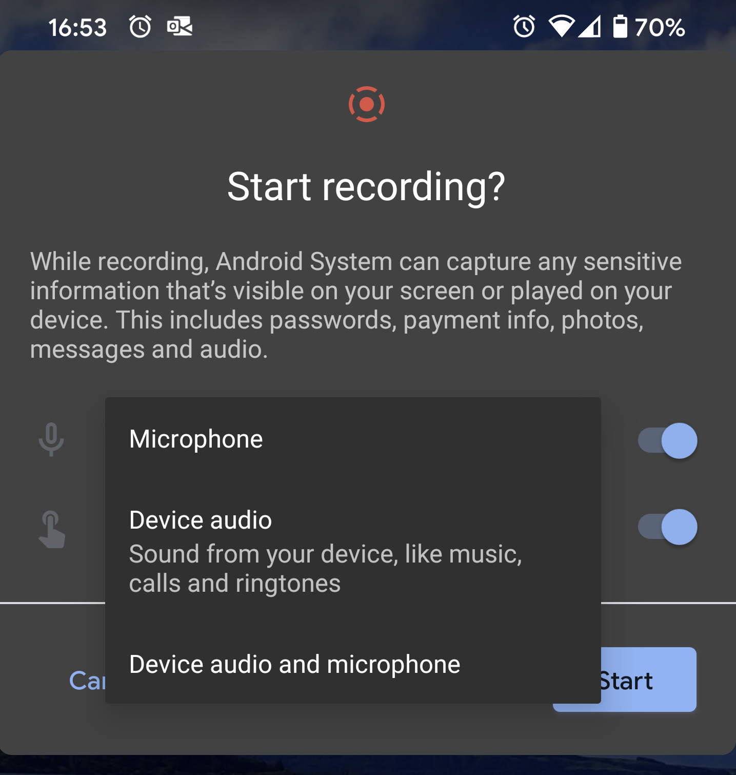
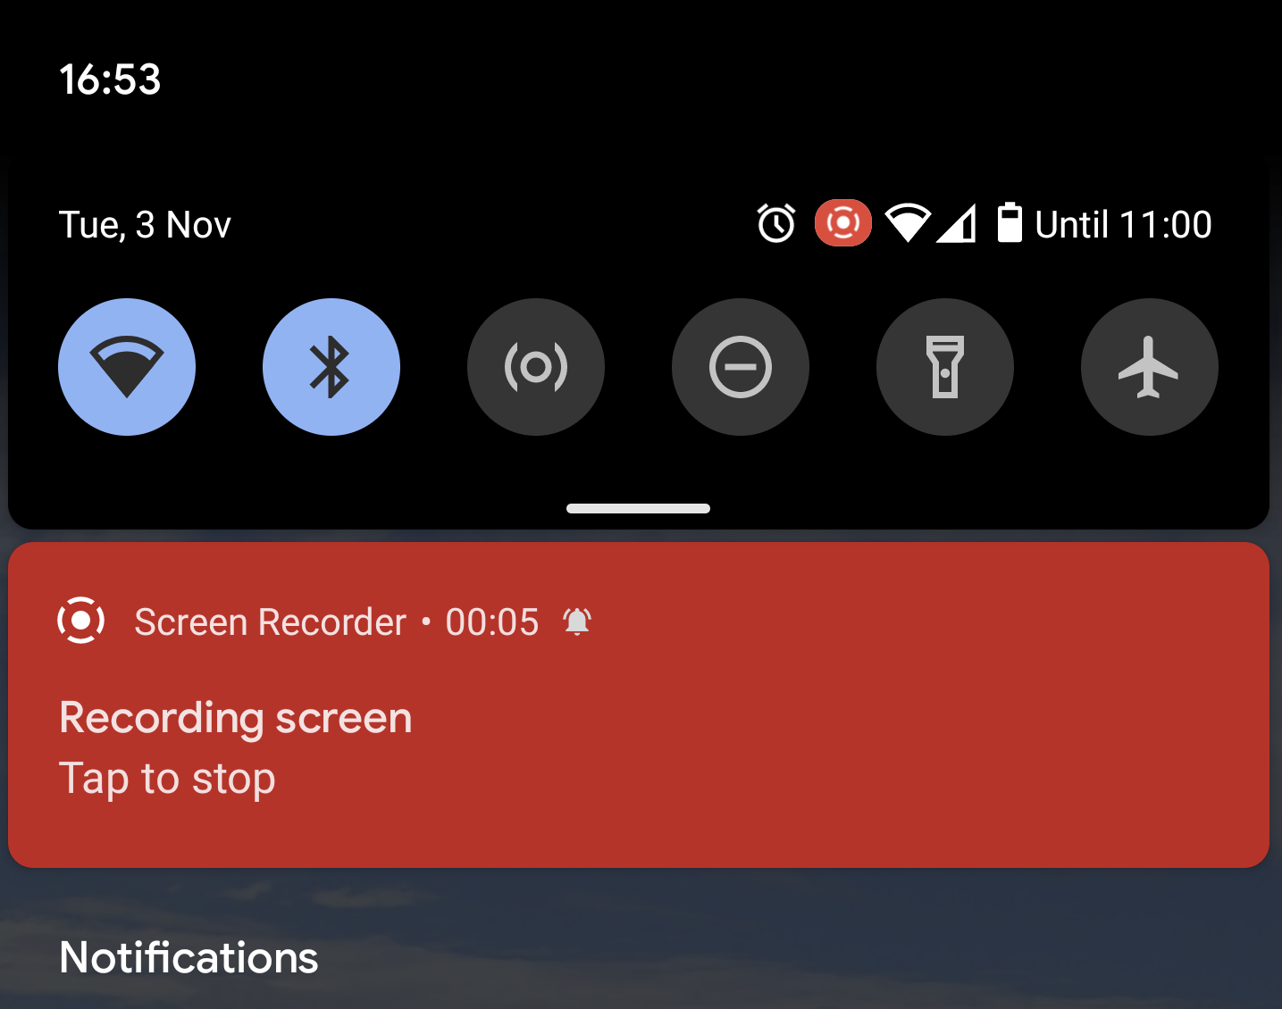
A11 Updates (Utilities)
Screen Recording
Screen recording built-in & available from quick-settings

Slide 37
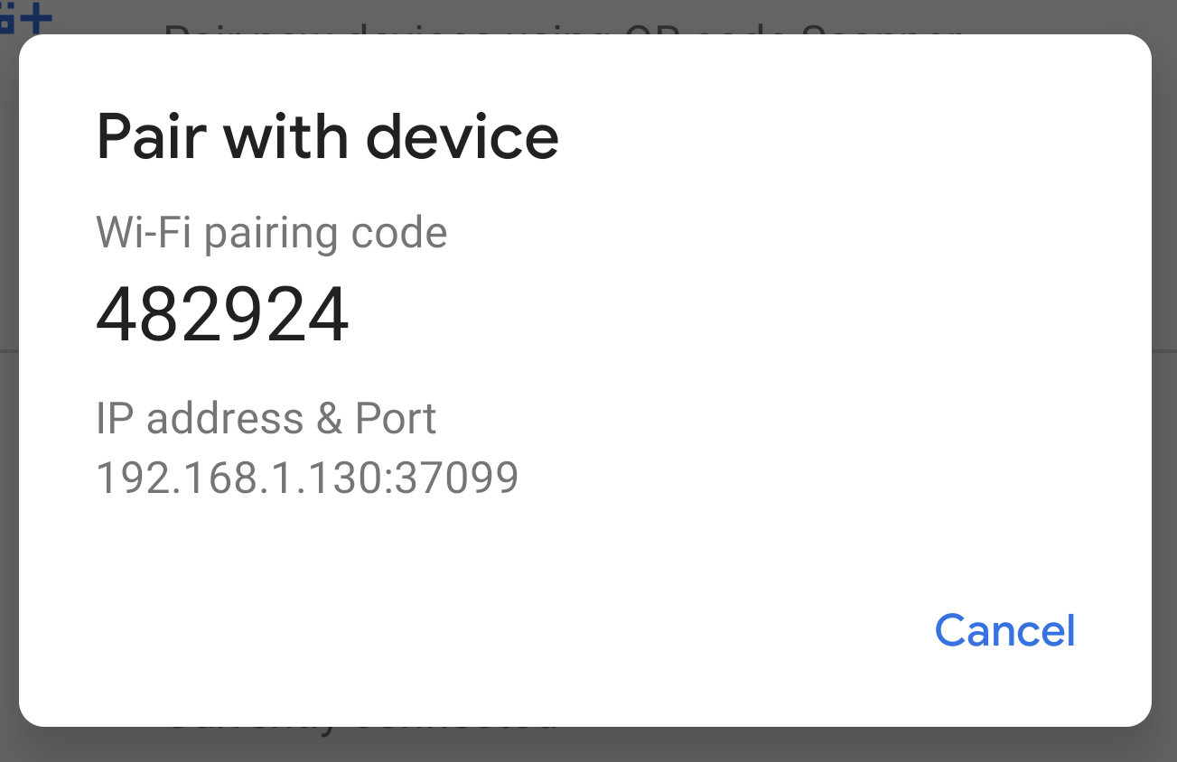
A11 Updates (Utilities)
Wireless ADB
Allows enabling Wireless Debugging without having to connect the device first
Official Docs
  Update to the latest SDK Platform tools
  Enable Wireless debugging from the developer options
  On the dialog that asks Allow wireless debugging on this network? Click Allow.
  Select Pair device with pairing code. Note the pairing code, IP address & port number.
  adb pair ipaddr:port using the IP address and port from the previous step
  Enter the pairing code from step 4.
  adb connect ipaddr:port using the IP address and port under wireless debugging

Slide 38
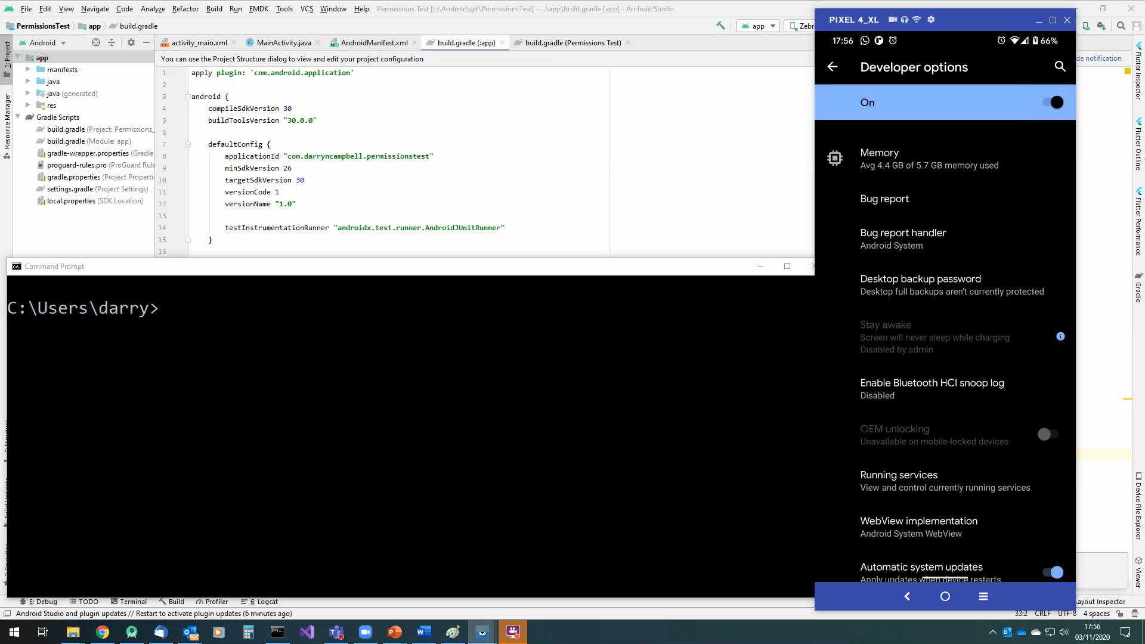
A11 Updates (Utilities)
Wireless ADB – demo from Darryn Campbell

Slide 39
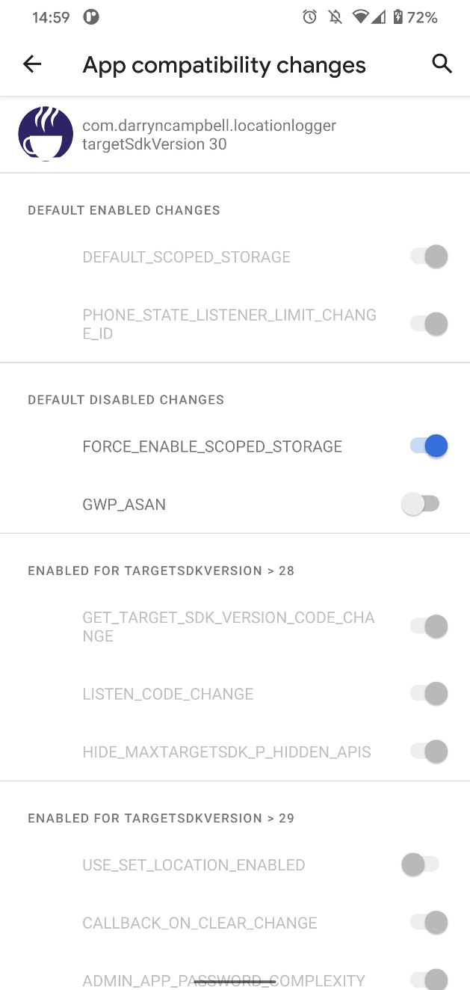
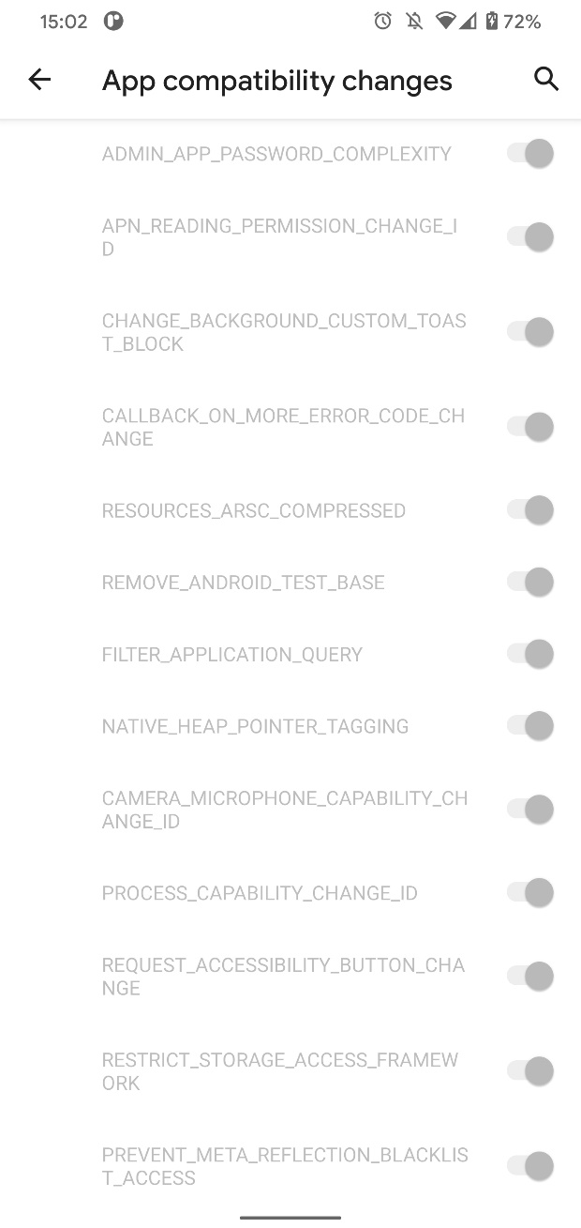
A11 Updates (Utilities)
Test App Compatibility
Selectively enable the new Android 11 restrictions
Useful for testing your app as you address the new Android restrictions incrementally.
Only (currently) applicable for changes from Android 10 -> Android 11
For testing / debugging only – not for use in production.

Slide 40
Questions?
James Swinton-Bland
Developer Advocate EMEA
James.swintonbland@zebra.com

